Slide 1

Newcastle University
Department of Civil Engineering and Geoscience
Subject:
Settlement of an elastic column under self-weight using MPM
By
Majid Goodarzi
Dec 2013

Slide 2

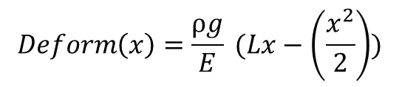
Example Description:
An elastic column settles under gravity force
E = 1e5 Mpa
nu = 0
Density = 1000 kg.m⁻³
Gravity = -1 & -2 m/s
Analytical Solution:
1 m
L =5 m
x

Slide 3
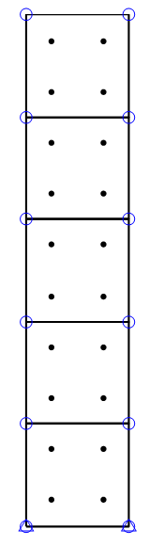
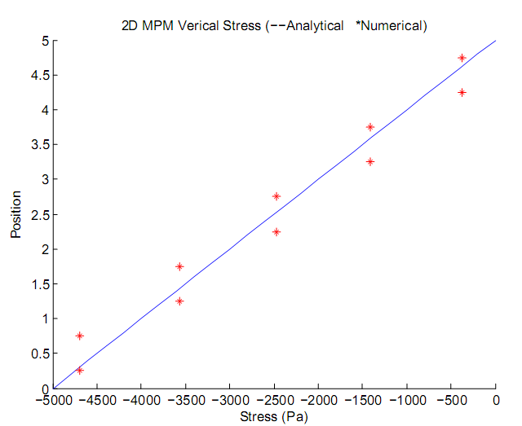
Results:
Gravity = -1 m/s

Slide 4
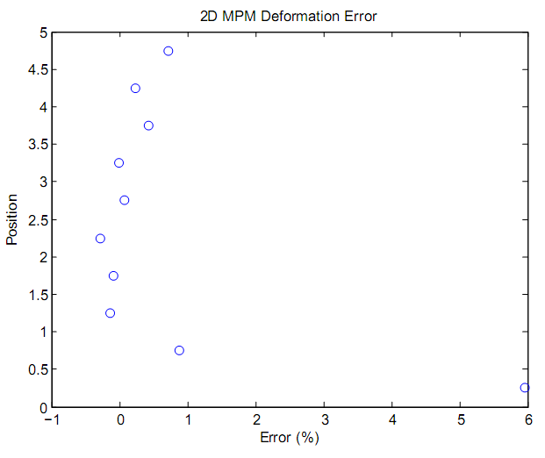
Results:
Gravity = -1 m/s

Slide 5
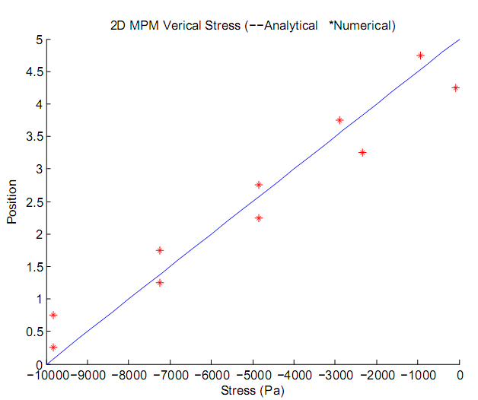
Results:
Gravity = -2 m/s

Slide 6
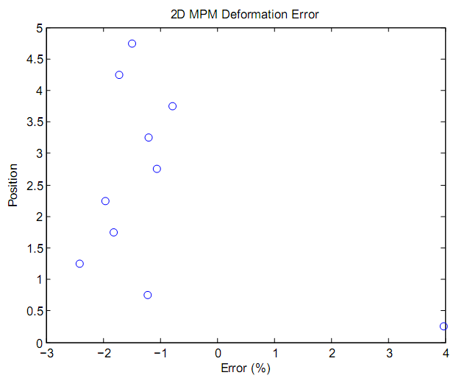
Results:
Gravity = -2 m/s

Slide 7
Results:
As it can be seen by increase the gravity which means by increase the relative movements of material points with respect to the computational mesh size, the error in deformation is heightened as well.

Slide 8
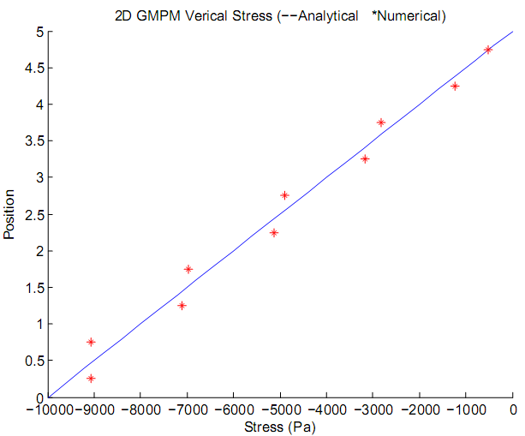
Results with GIMPM:
Same examples are simulated using GIMPM.
Gravity= -2 m/s

Slide 9
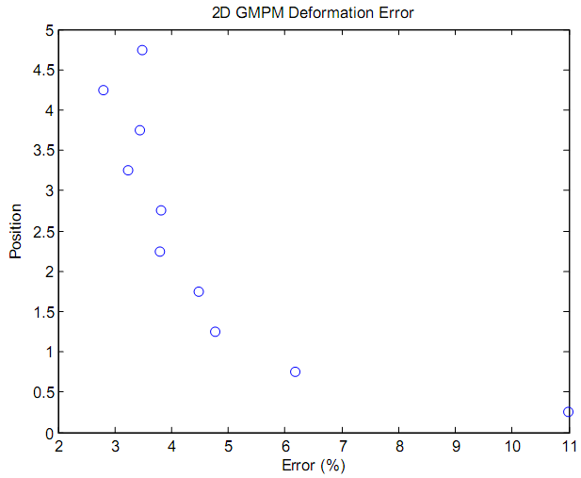
Results with GIMPM:
Same examples are simulated using GIMPM.
Gravity= -2 m/s

Slide 10
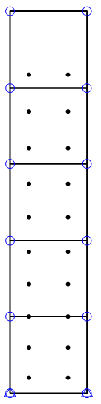
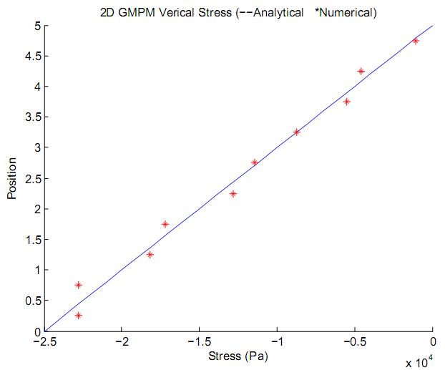
Results with GIMPM:
Gravity force is increased to -5 m/s to push particles to cross the elements.
Deformed configuration

Slide 11
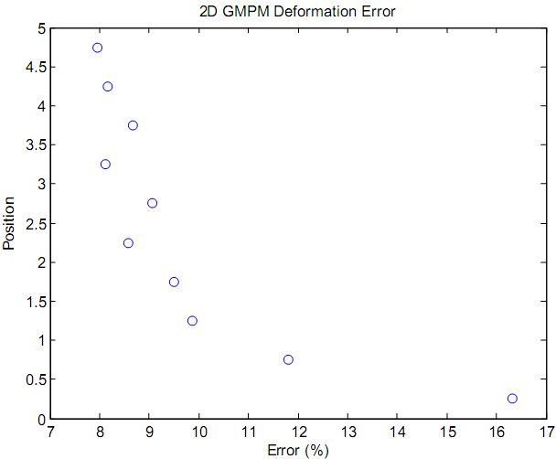
Results with GIMPM:
Gravity force is increased to -5 m/s to push particles to cross the elements.
Deformed configuration

Slide 12
Results with GIMPM:
Through these examples, it has been clearly observed that the deformation cannot be accurately captured by the developed code while the stress is completely acceptable.
In addition, GIMPM shows more error in displacement but more accuracy in stress.
A finer mesh size or more particles per cell have not improved the error in this example.

